Slide 1

Dr. Thorium
or: How I learned to stop worrying and Love Nuclear Power
Spencer Swartz
Notes:
http://thehill.com/special-reports/energy-a-environment-september-2010/120419-top-10-reasons-nuclear-power-will-be-the-key-to-americas-energy-future
https://qz.com/89336/everything-you-thought-you-knew-about-the-risks-of-nuclear-energy-is-wrong/

Slide 2
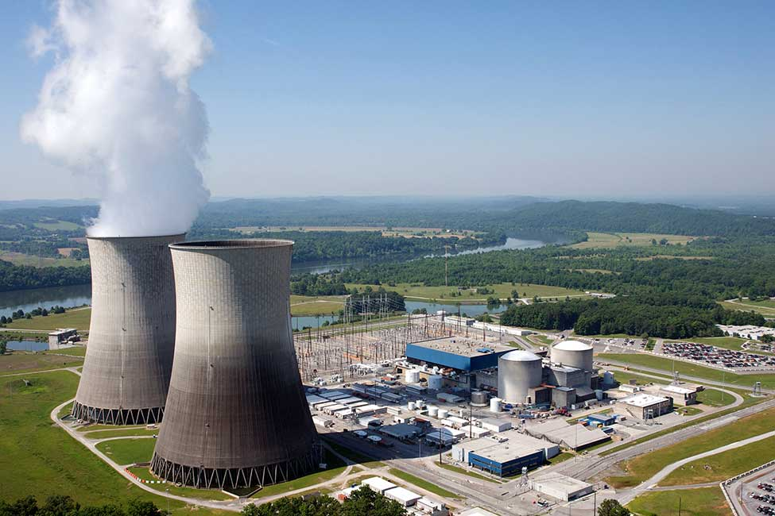

Slide 3


Slide 4

1.Zero emissions

Slide 5
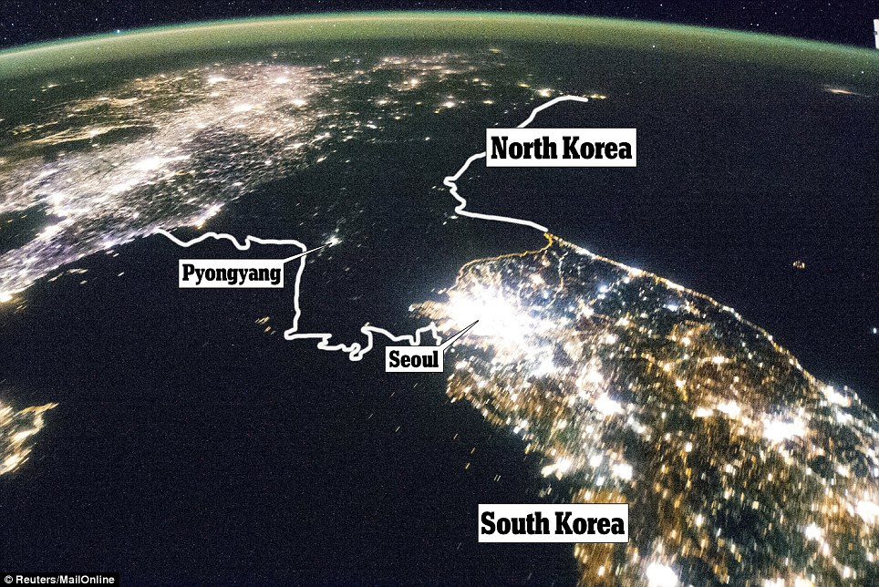

2. Reliability

Slide 6
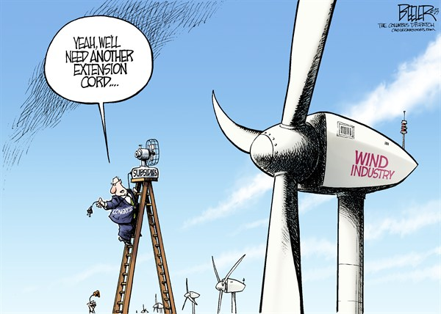
3. Low Cost

Slide 7

4. Land Conservation

Slide 8
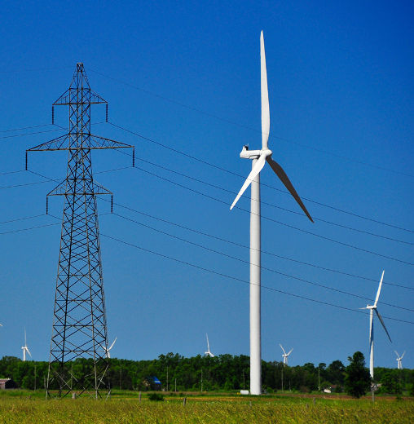
5. Fewer new transmission lines

Slide 9
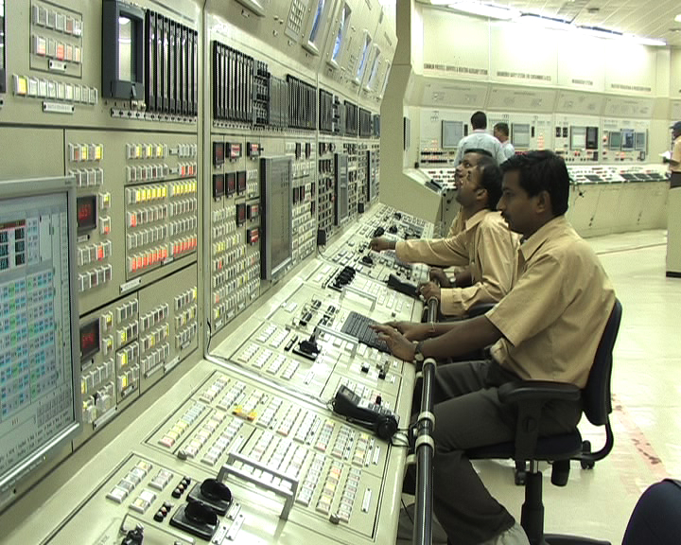
6. jobs

Slide 10

7. Reducing nuclear Arms

Slide 11

8. International Competitiveness

Slide 12
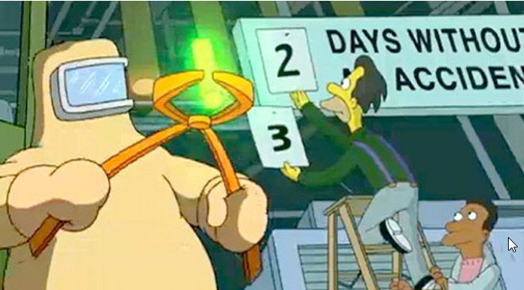
9. Safety

Slide 13

10. Public Support

